Slide 1
Example of on-ground activation plan

Slide 2
Pantaloons Store Launch (Bangalore)
Example

Slide 3
Objective
The main objective of the on-ground activation campaign for Pantaloons was to create a lot of buzz for the new store opening of Pantaloons in Bangalore.
Activities chosen for the “On-ground activation” campaign:
Leaflet Distribution
Event setup in the mall
Artists Visits
Social media posts by the artists.

Slide 4
Execution images of the campaign organized by RED FM 93.5

Slide 5
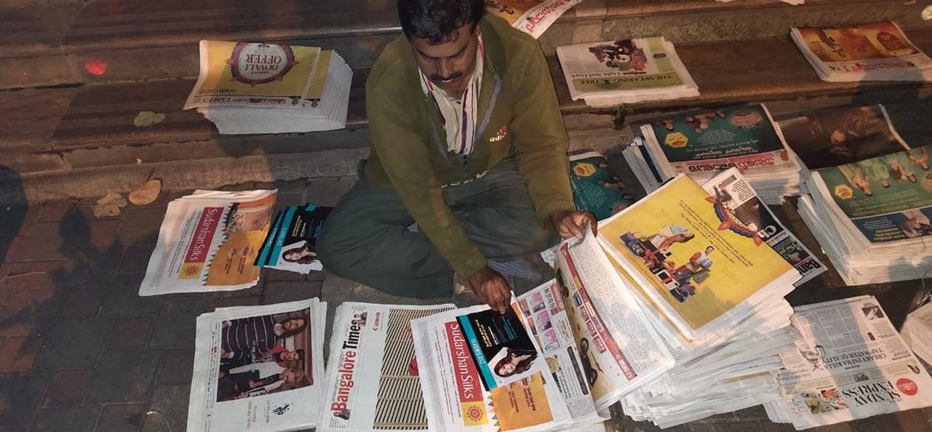
Leaflet Distribution

Slide 6
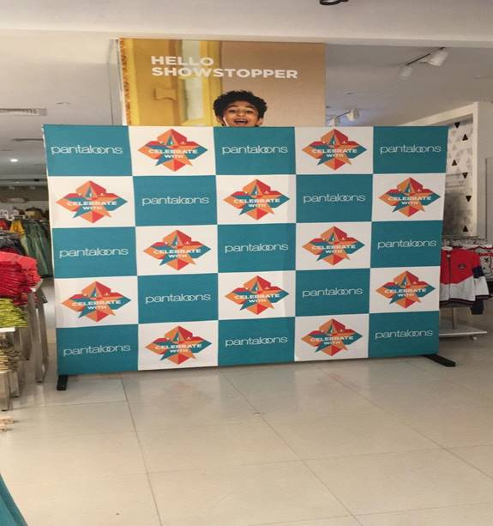
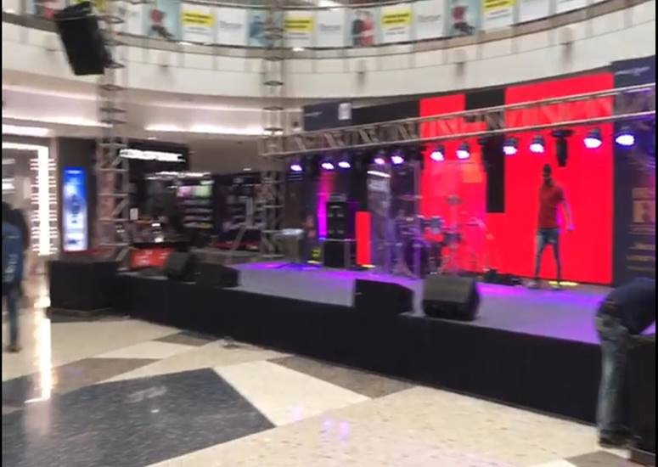
Event setup in the mall

Slide 7
Artist visit in the mall

Slide 8
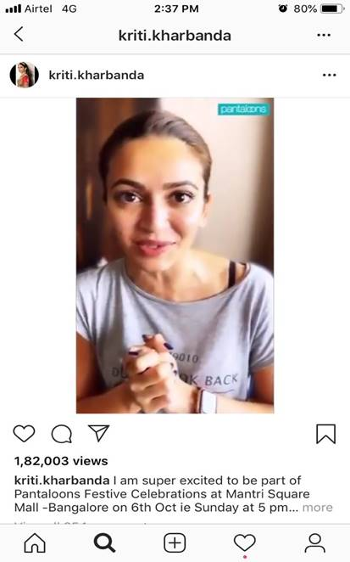
Social media posts by the Artists

